Slide 1
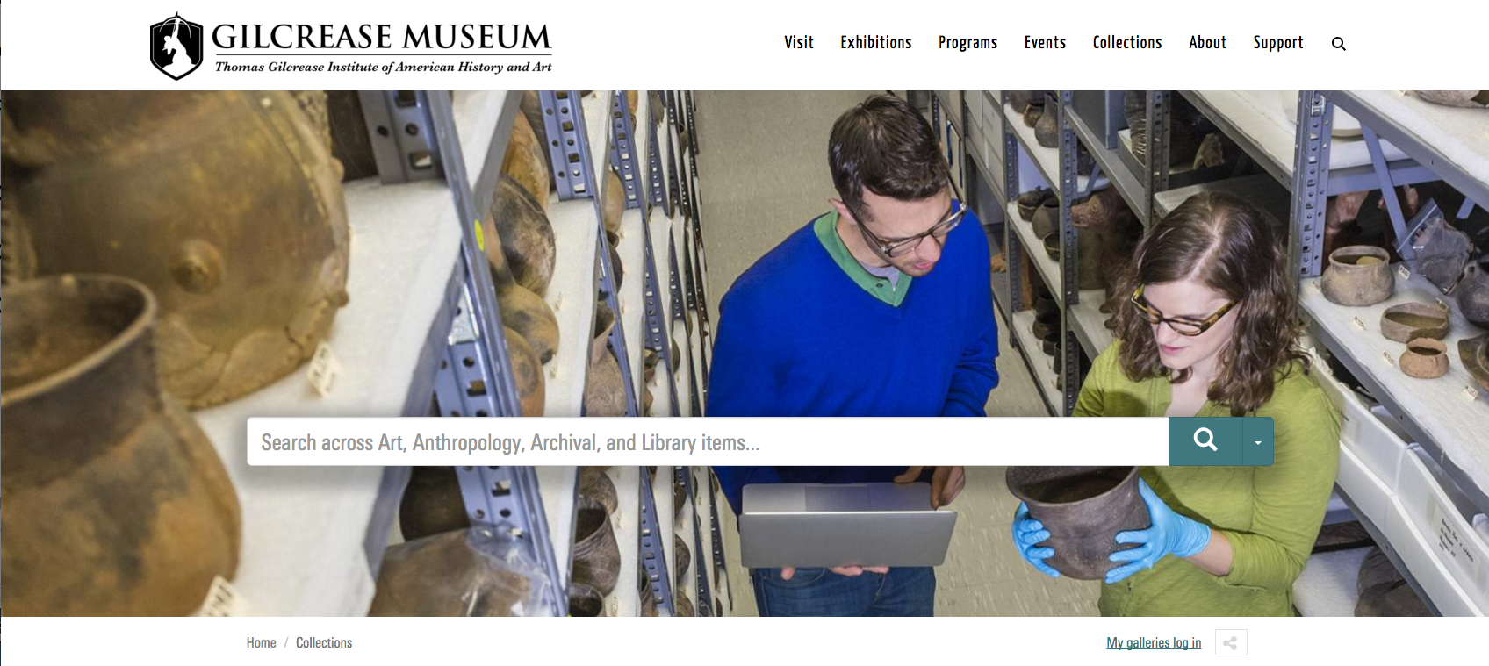
Adding Art into the Digital Humanities
Adding Art into the Digital Humanities:
Combining and Shaping Data at the Gilcrease Museum
COMBINING AND SHAPING DATA AT THE GILCREASE MUSEUM
http://collections.gilcrease.org
Diana Folsom, Director of Digital Collections, Gilcrease Museum

Slide 2
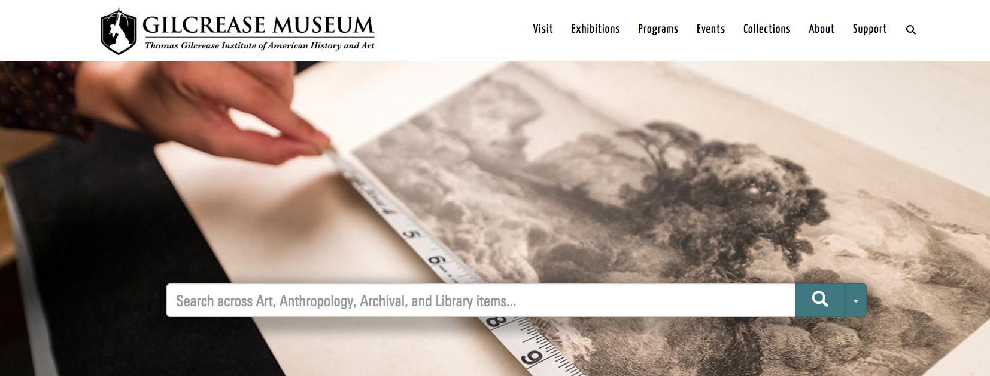
Ideals and Practical methods
http://collections.gilcrease.org
Diana Folsom, Director of Digital Collections, Gilcrease Museum
Notes:
Another subheading! ☺

Slide 3
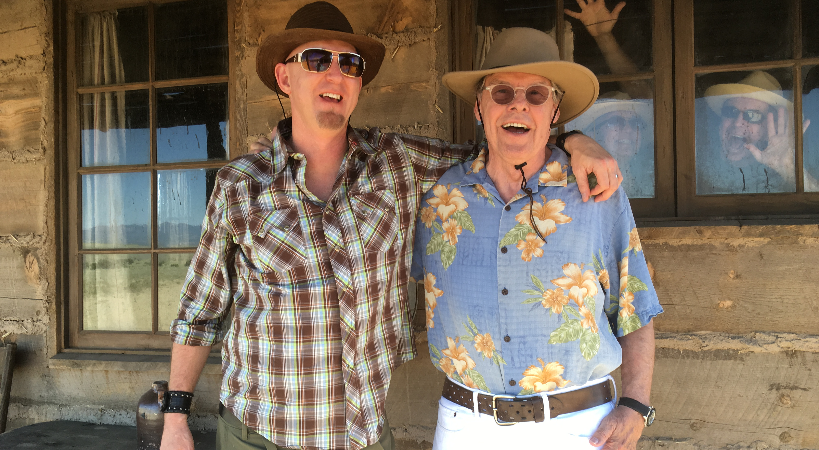
Ideals inspired by users
My designer husband
on a Netflix set

Slide 4
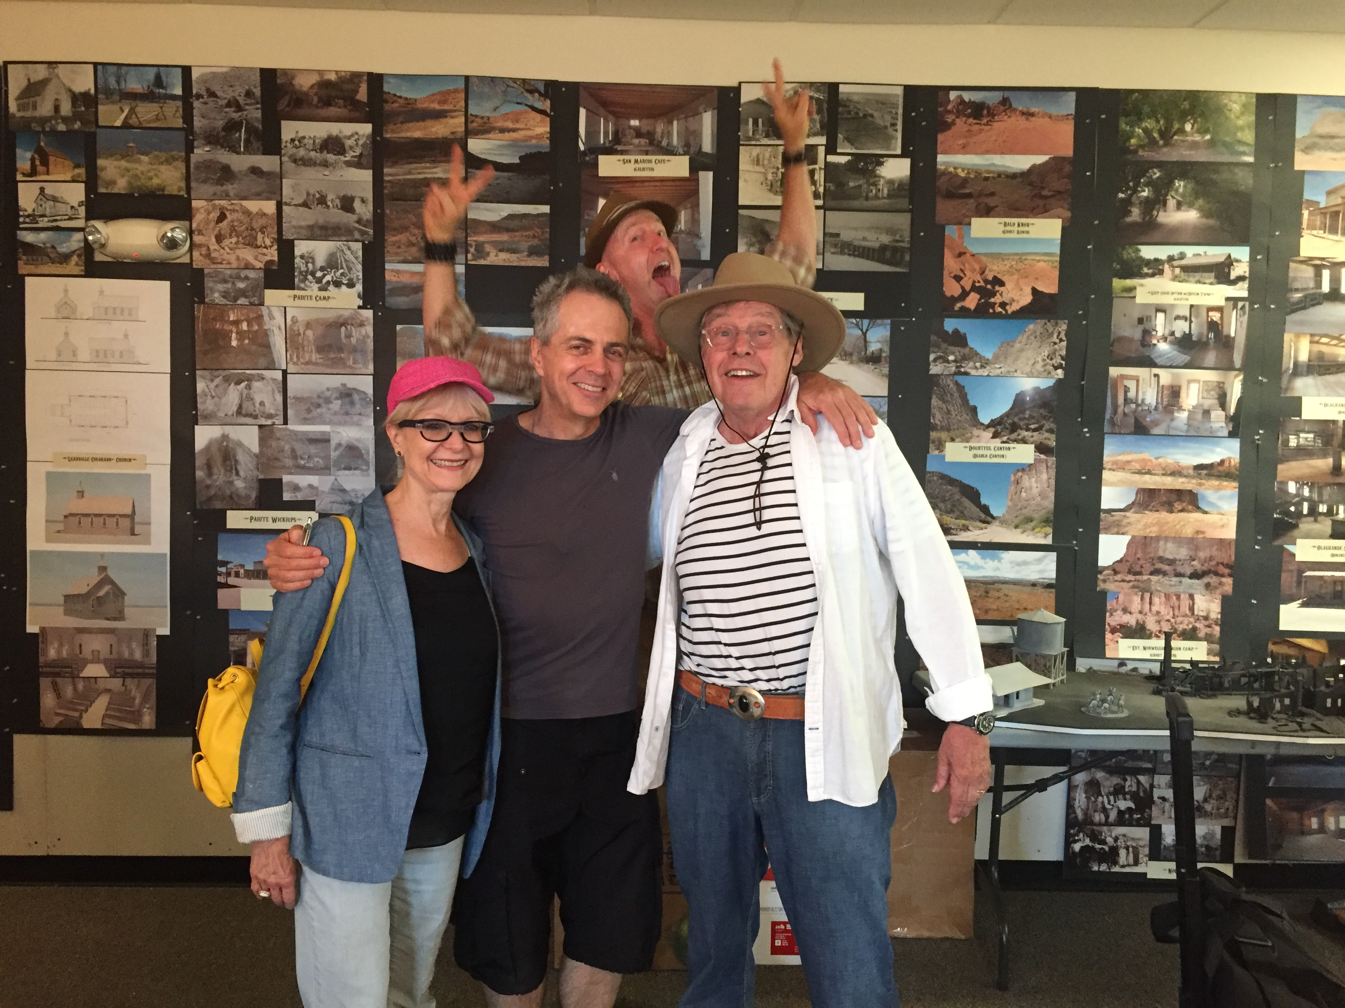
Inspiration: one of their many research walls

Slide 5
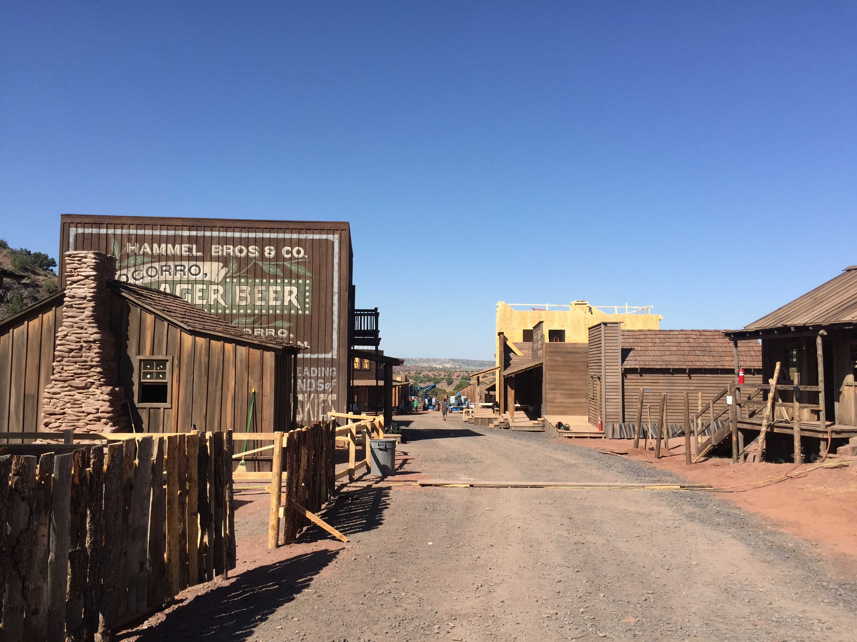
Results of research: set for a town (under construction)

Slide 6
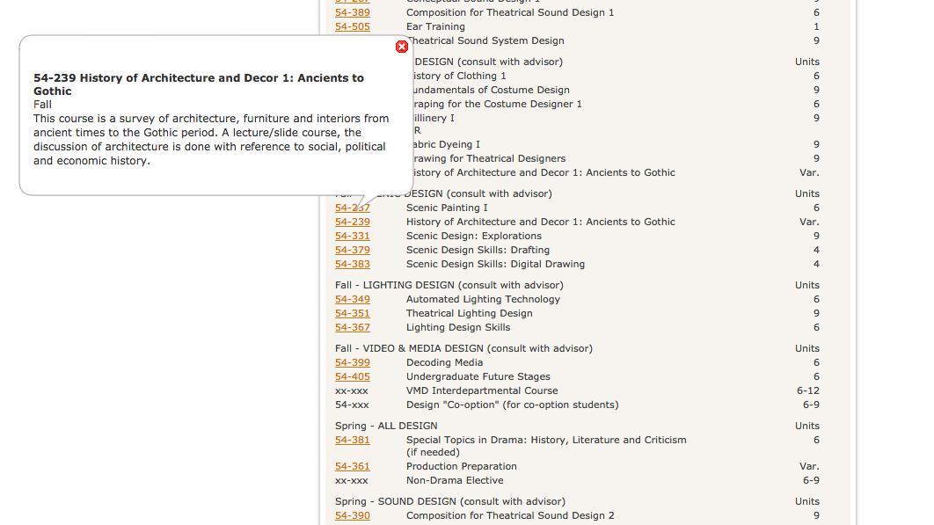
His education (Carnegie-Mellon) used arts to teach
social, political and economic history
Learned to research, research, research!
Notes:
Stressed Research! Research! Research!

Slide 7
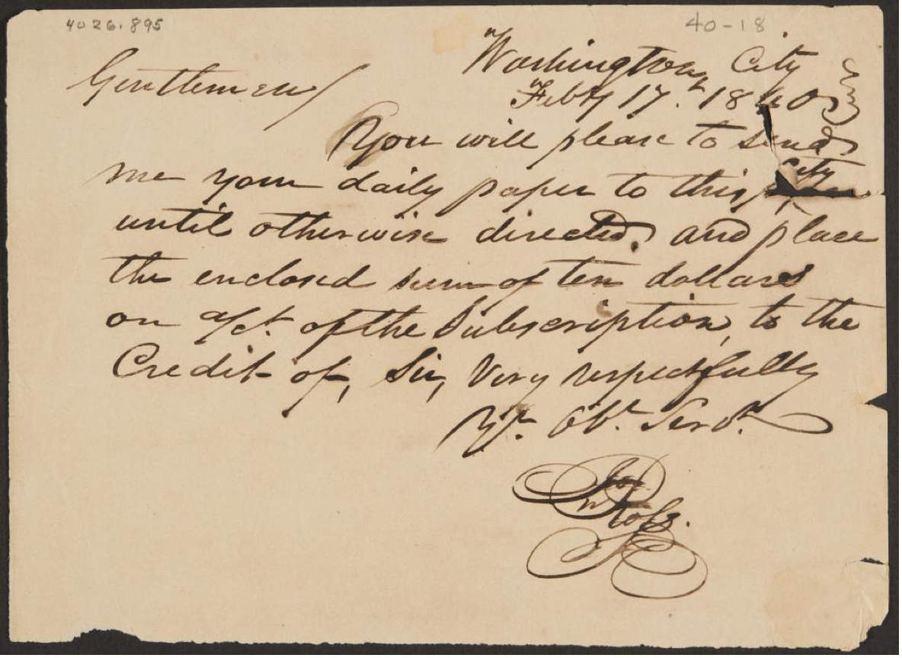
Putting Ideals Into Practice
Ideal: to support researchers and this integrated style of education
In practice: we launched with 20,000 items in four years
preparing for the semantic web
(400,000 to go)
Notes:
Museums have tended to work in an isolated way, Gilcrease Museum is unique because our collections are strong in so many areas that are typically siloed.

Slide 8
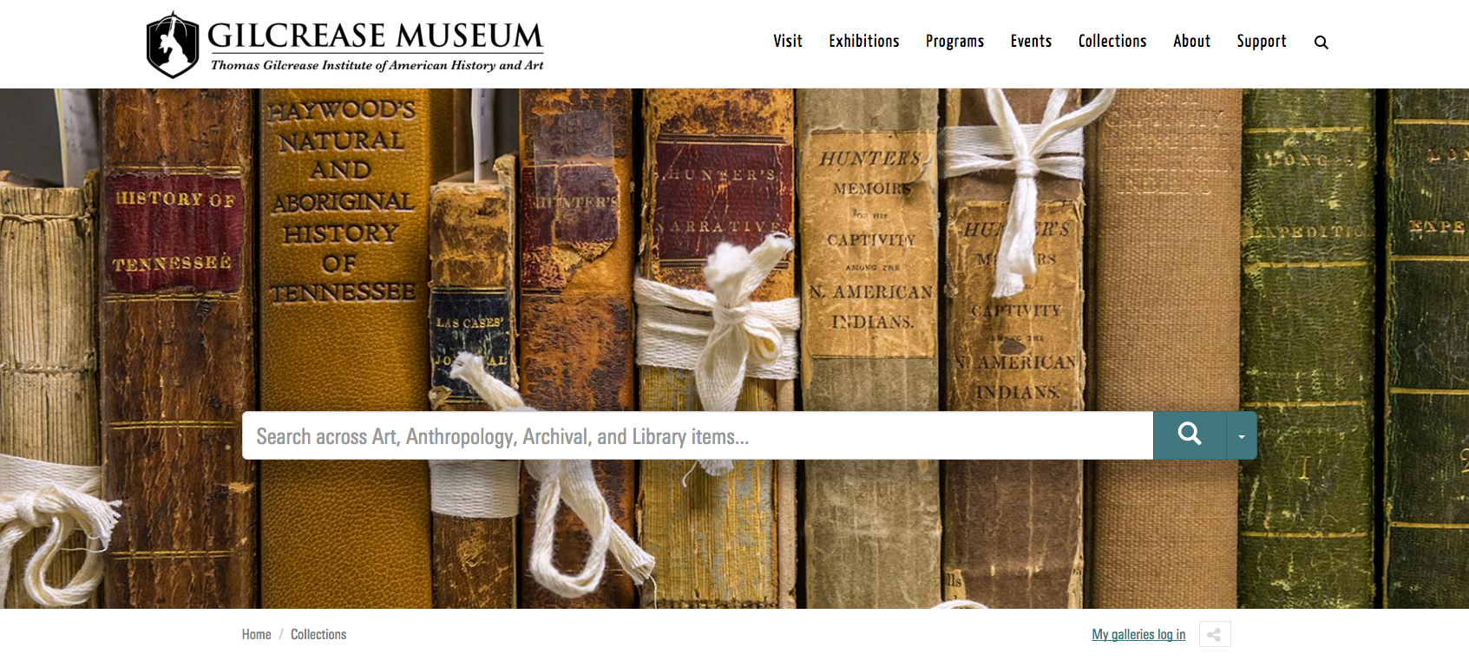
Gilcrease collections = history of North America
(Ancient to Modern, Native to European)
fruitful cross-disciplinary research
Notes:
Art Miuseum reposotories have been organized around looking – historical information is often called “context”

Slide 9
Our Practices:
Leverage knowledge and experience from consortial projects:
  (since 1996) AMICO, ECI, Steve, ArtBabble, OSCI, and now the American Art Collaborative
Catalogue/Image rapidly and simply
Create Distance Cataloguing software (DCI)
Invite outside experts to review; add data
Transform our data to LOD for the internet (Semantic web)
Strong online presence
Notes:
“recombinant potential” (Lorcan Dempsey)

Slide 10
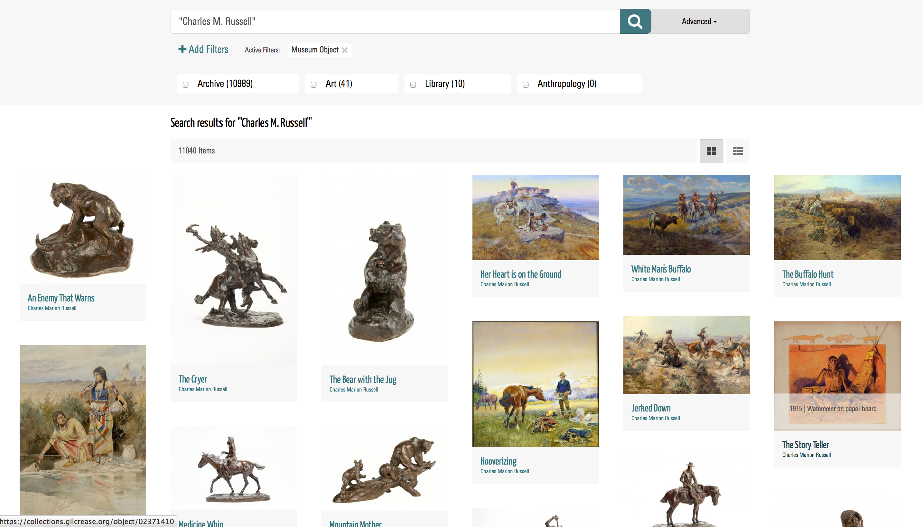
Fairly productive search results
A sampling of records from each area

Slide 11
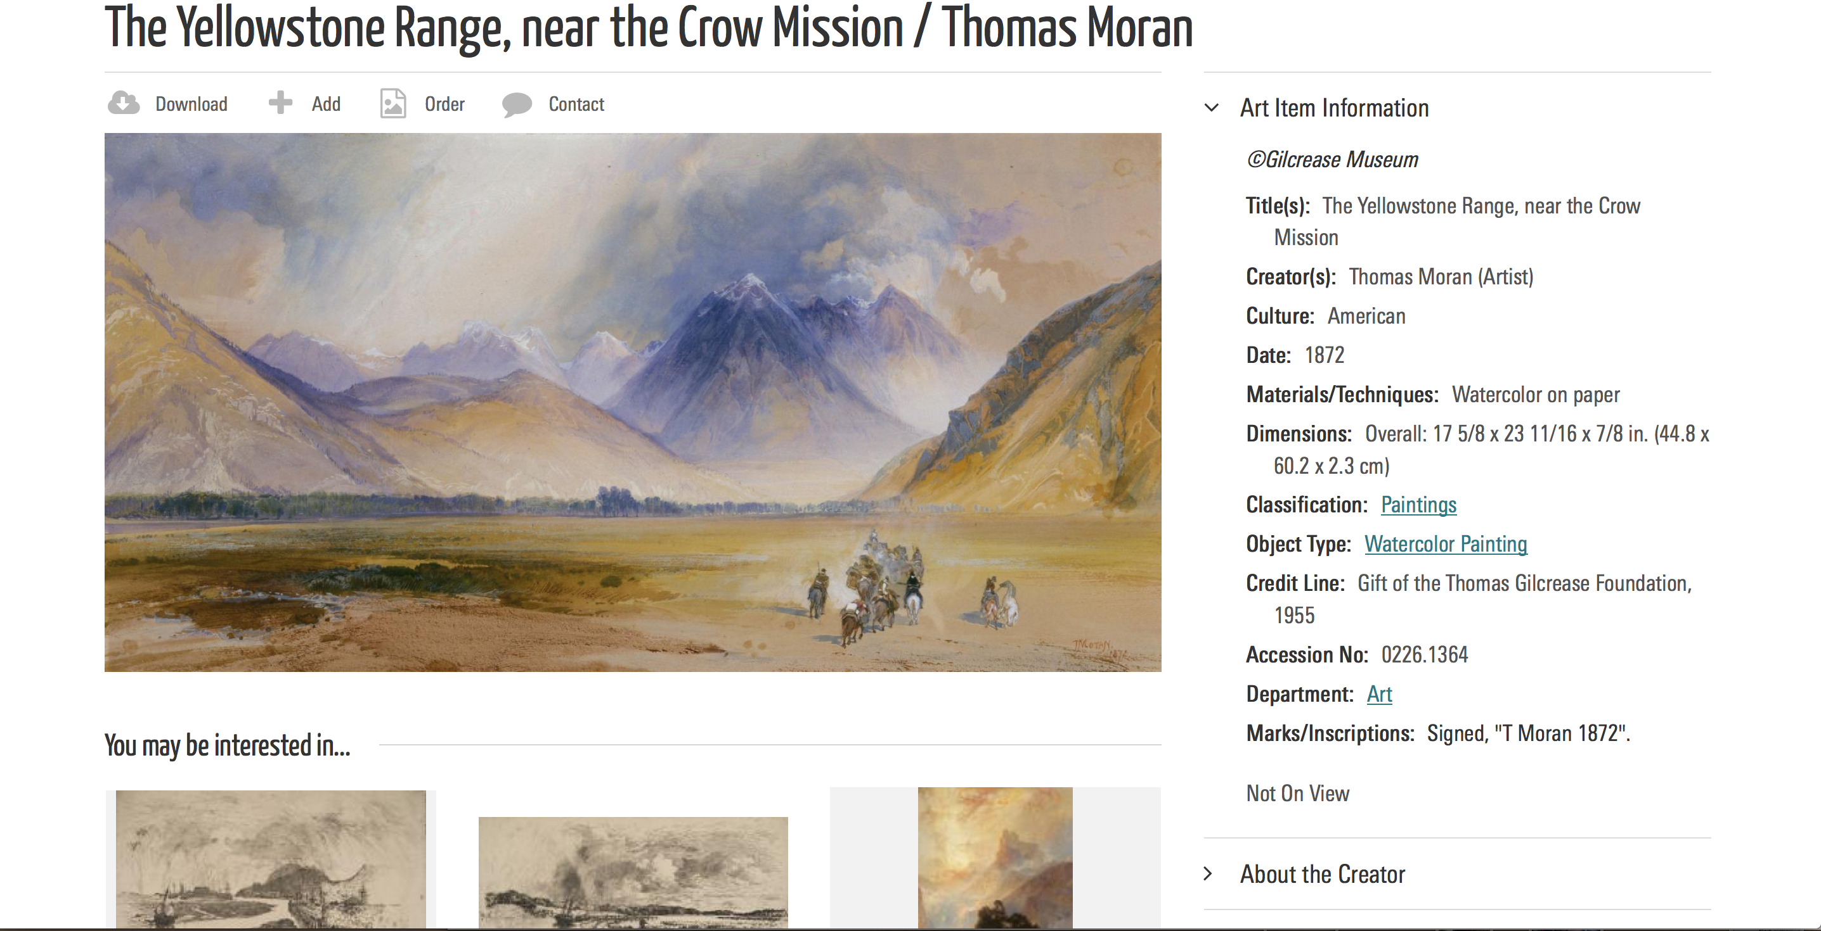
Basic data

Slide 12
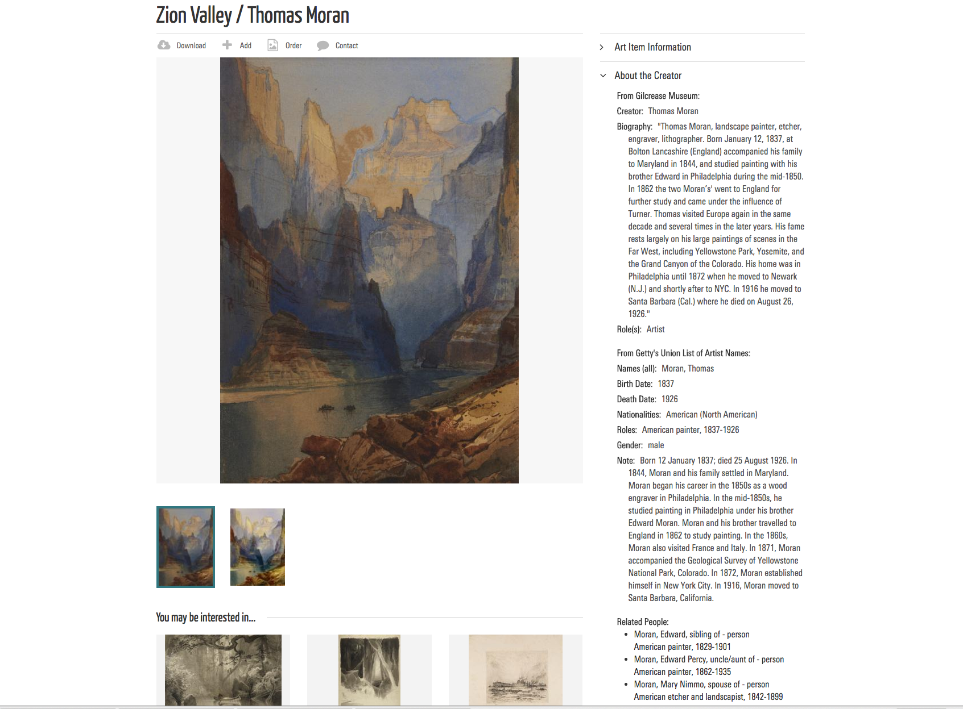
Artist bio pulled from the semantic web

Slide 13
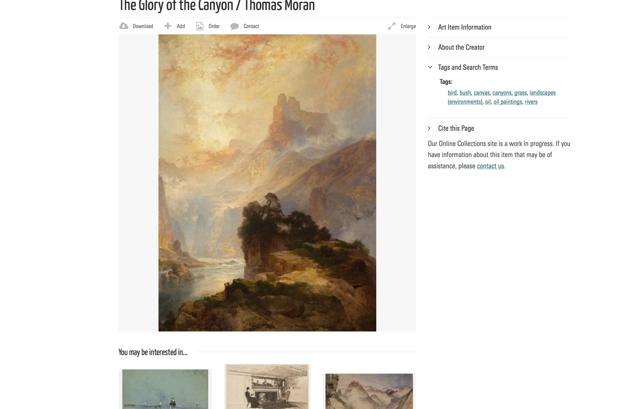
Tags
Who, What, When, Where

Slide 14
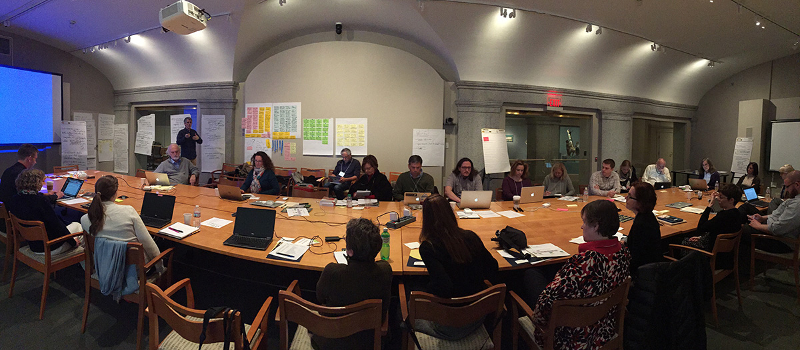
American Art Collaborative
Linked Open Data (LOD) on The Semantic Web
The future is here!
February 2015 AAC meeting, hosted by the Smithsonian American Art Museum (SAAM)
16 Art Museums plus the Archives of American Art
Mellon and IMLS funded

Slide 15
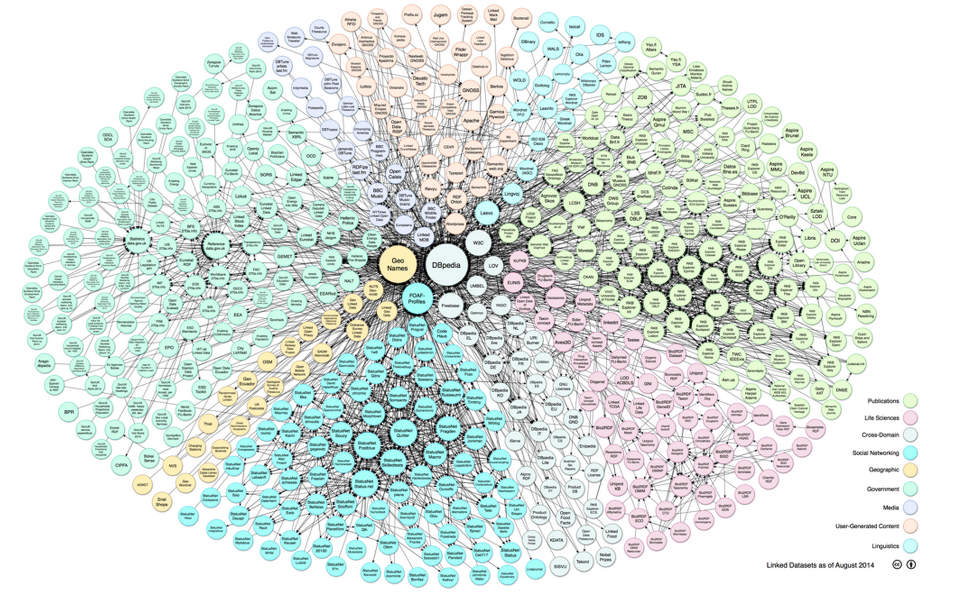
LOD CLOUD of information
Window to the Universe of Knowledge
Media
NYTimes
Library
Government
Map of the Linked Data Cloud
30+ billion facts and growing
Knowledge
Getty AAT
Geographic
Science

Slide 16
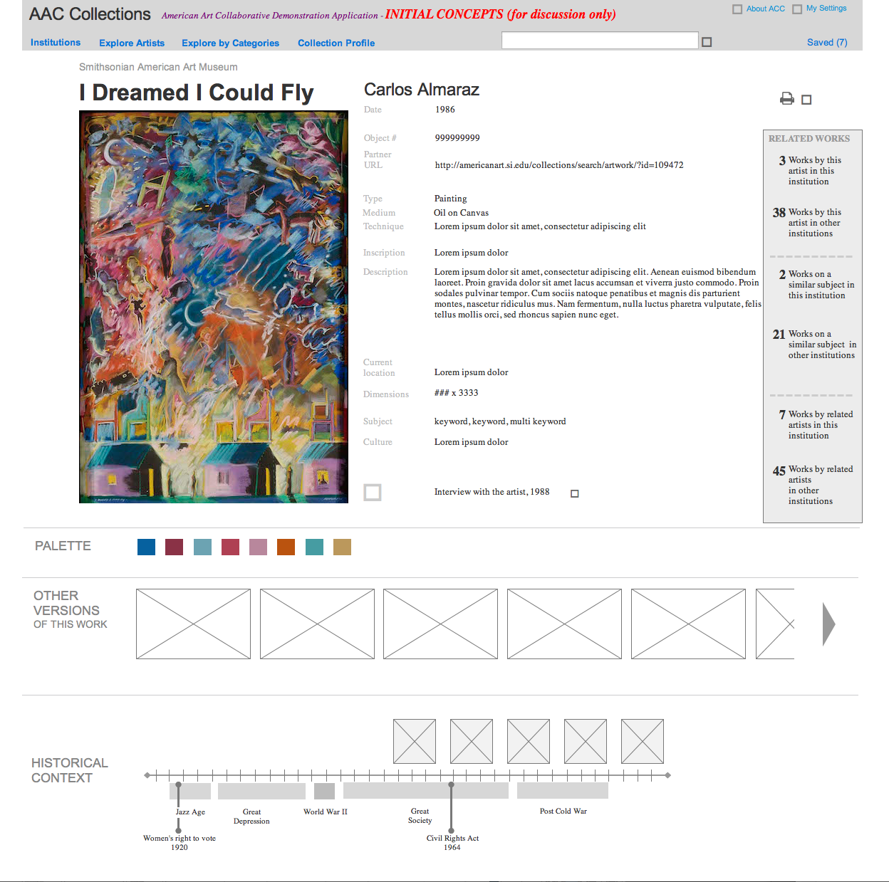
Wireframes for new apps to use this ”Universe of Knowledge”

Slide 17
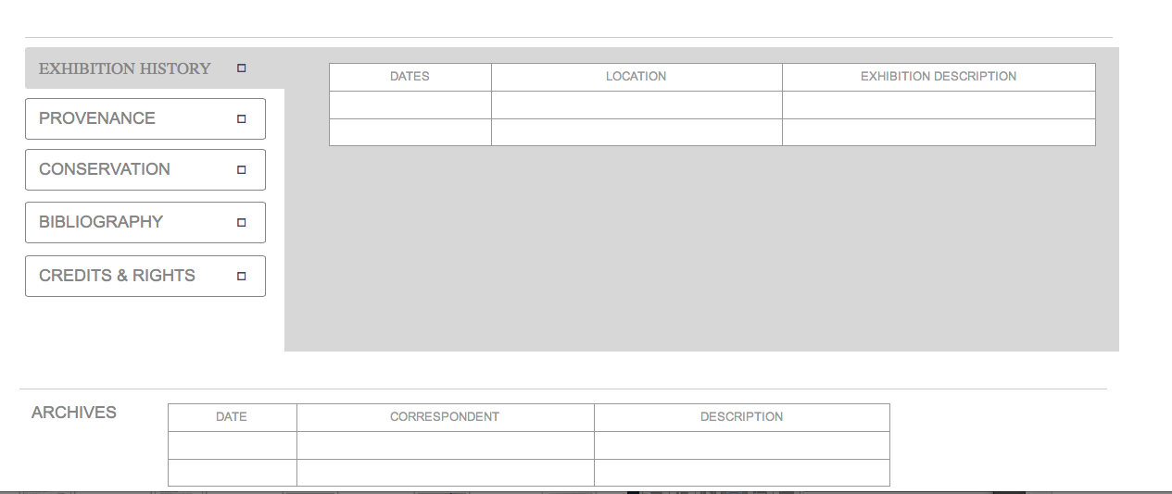

Slide 18
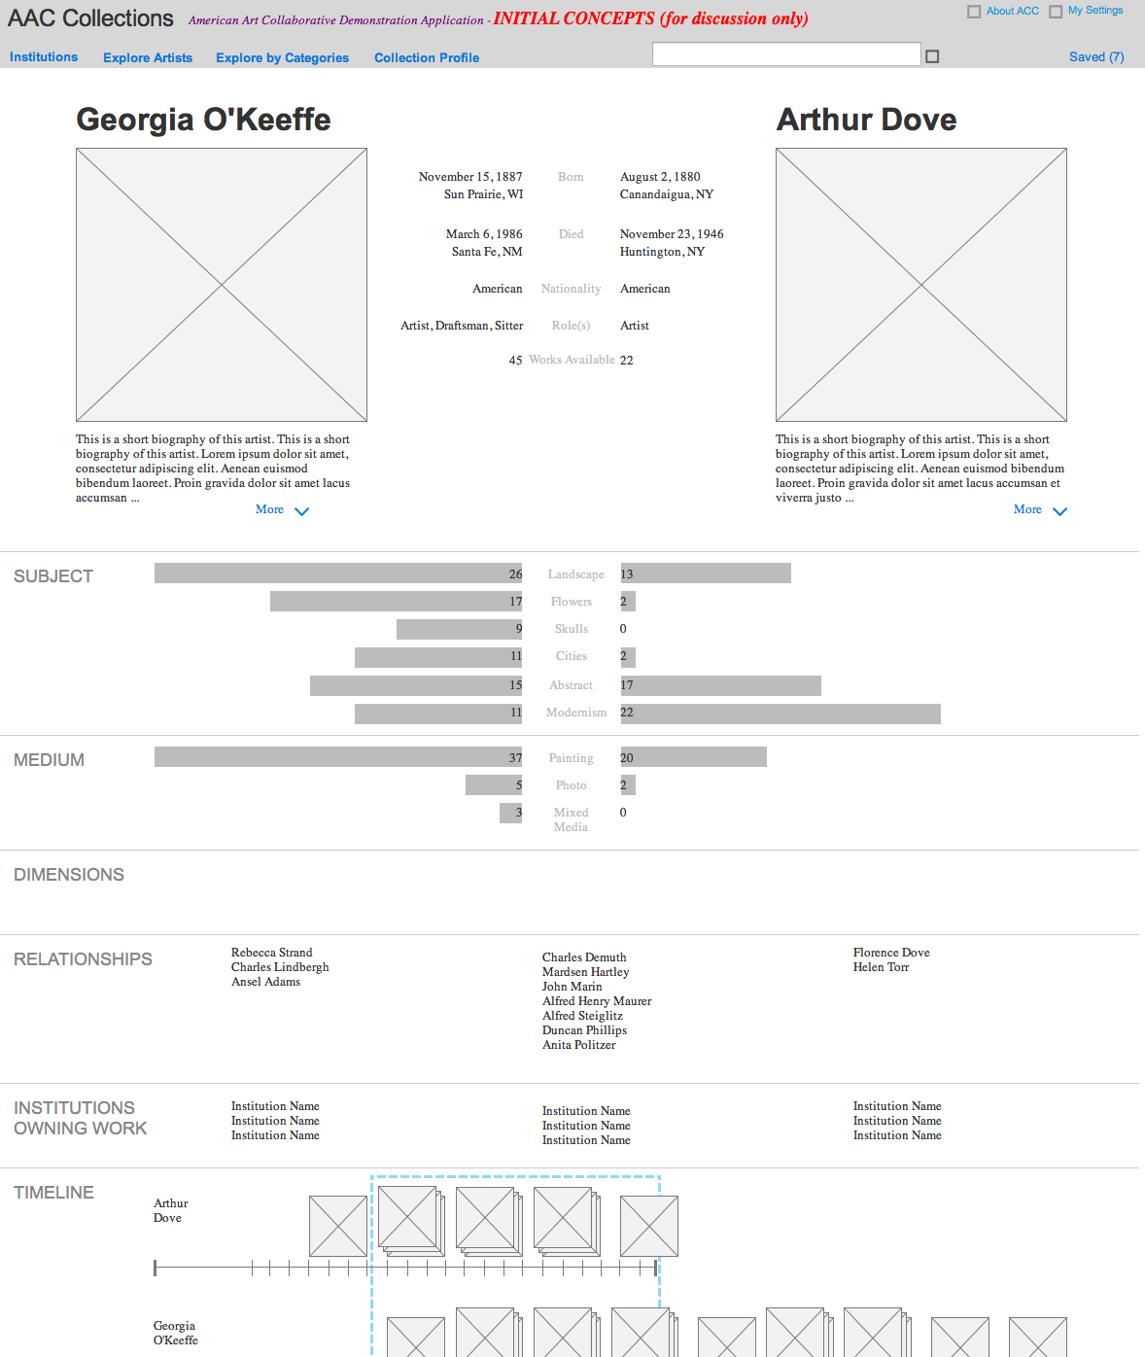

Slide 19
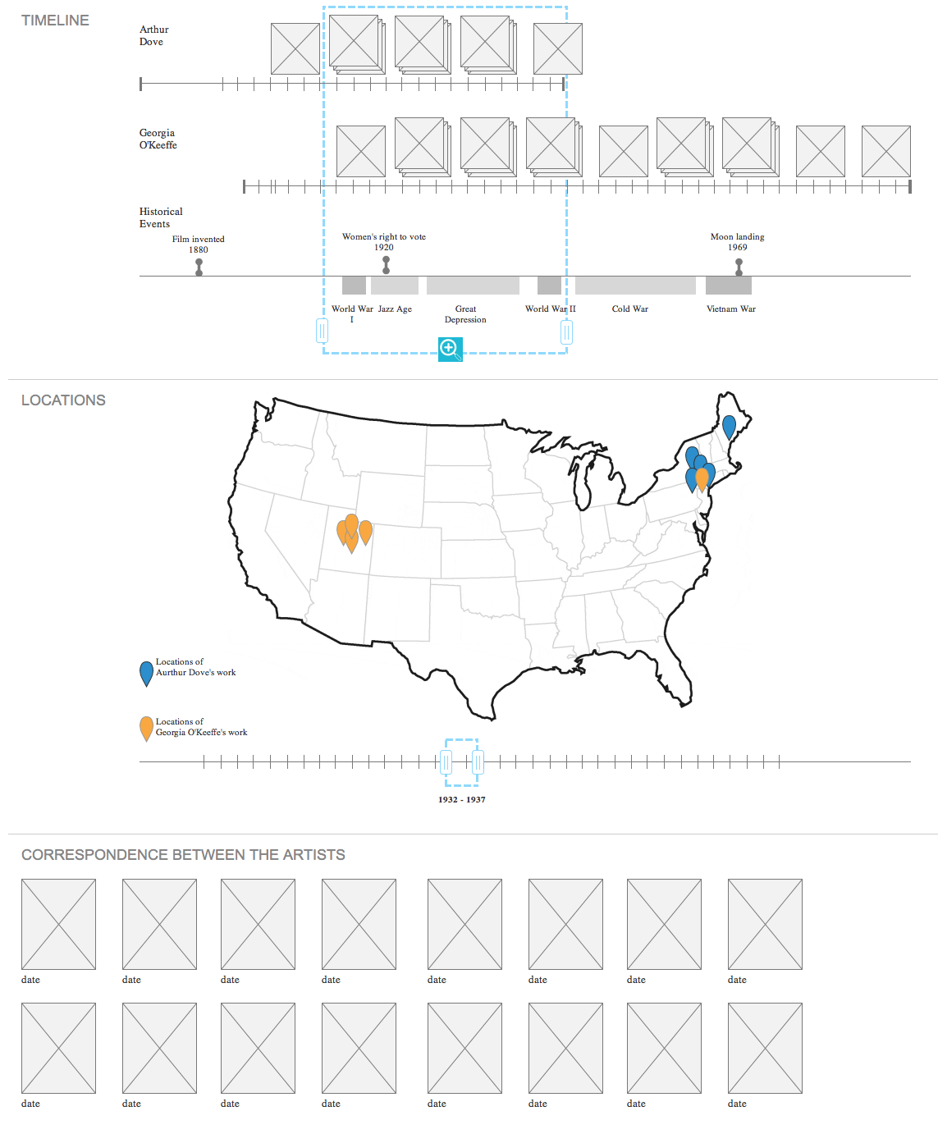

Slide 20
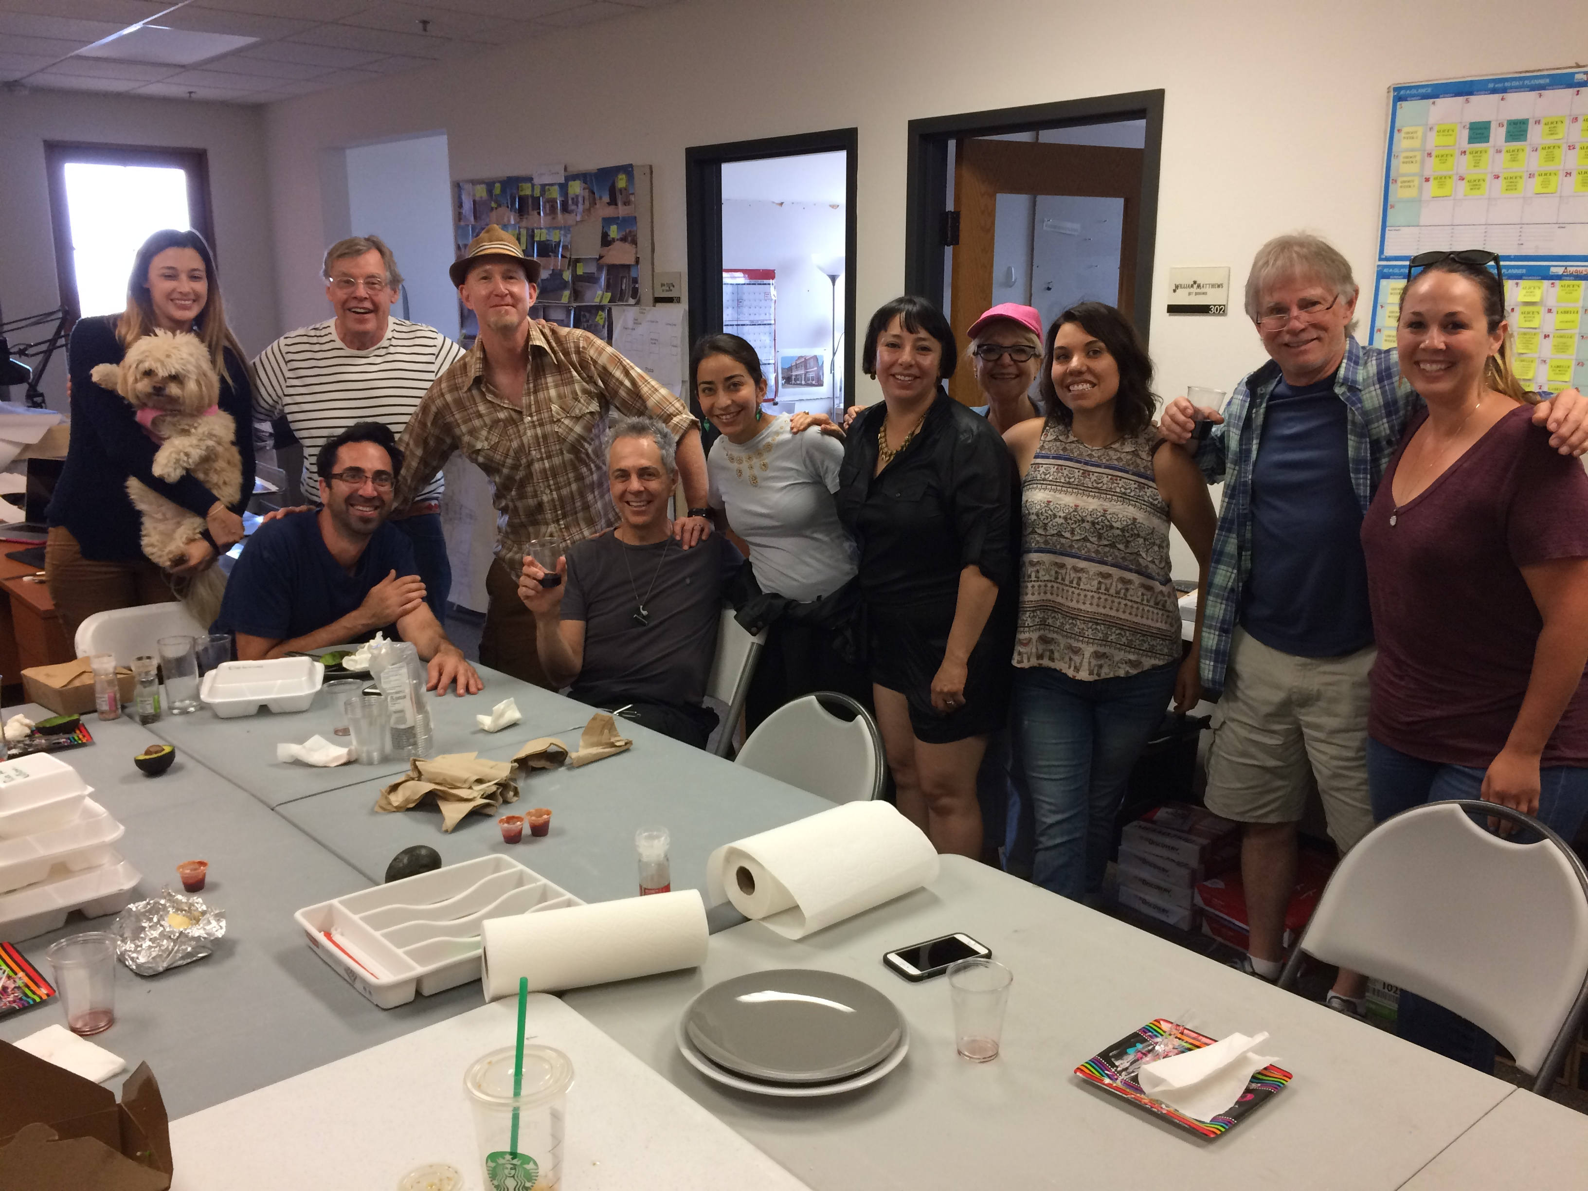
The future is here –
Making all of our data useful for this crew!

